Slide 1
University of Diyala
College of Engineering
Department of Architecture
1ST Stage
2018 – 2019
Lecture_ 08

Slide 2
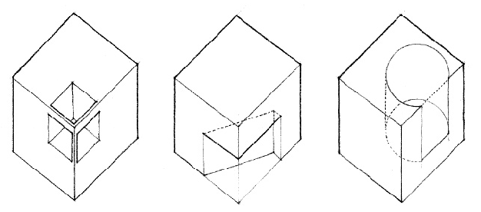
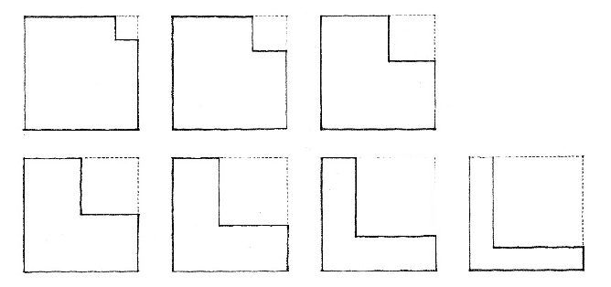
SUBTRACTIVE FORM

Slide 3
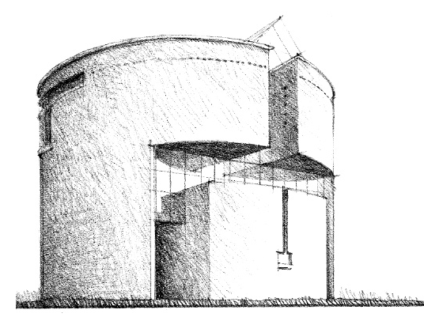
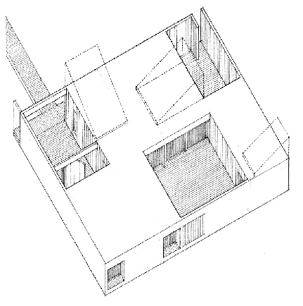
SUBTRACTIVE FORM

Slide 4
ADDITIVE FORM

Slide 5
Spatial Tension
This type of relationship relies on the close proximity of the forms or their sharing of a common visual trait, such as shape, color, or material.

Slide 6
2. Edge-to-edge Contact
In this type of relationship, the forms share a common edge and can pivot about that edge

Slide 7
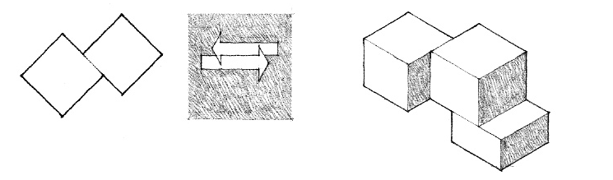
3. Face-to-face Contact
This type of relationship requires that the two forms have corresponding planar surfaces which are parallel to each other

Slide 8
4. Interlocking Volumes
In this type of relationship, the forms interpenetrate each other’s space. The forms need not share any visual traits

